Slide 1

Interactive Websites:
Using Boost.Beast WebSockets and Networking TS
Vinnie Falco
Author of Boost.Beast
CppCon 2018
Sep 23-29

Slide 2
http://cppalliance.com

Slide 3
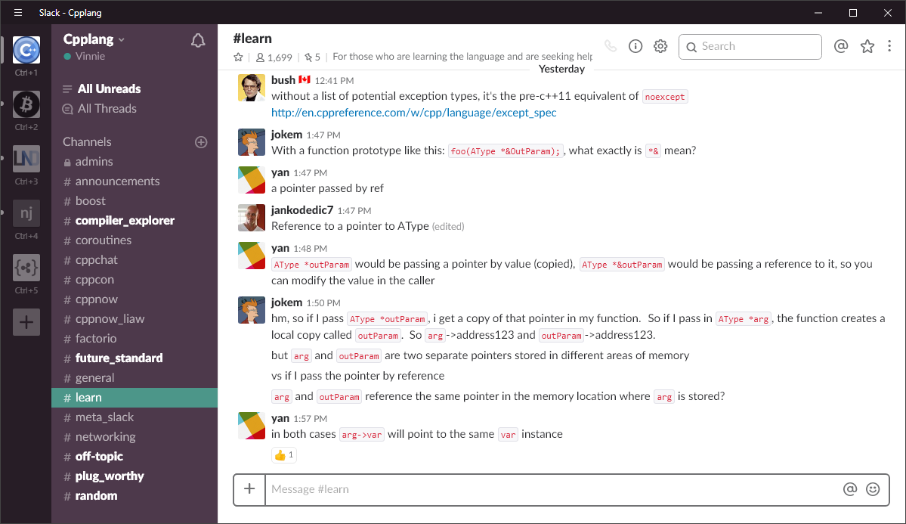
C++ Community
https://cpplang.slack.com
Sign up here:
https://cpplang.now.sh/

Slide 4
Boost.Beast
HTTP and WebSocket protocols
Using Boost.Asio
Header-only C++11
Part of Boost 1.66.0 and later
Goal: Standardization
https://github.com/boostorg/beast

Slide 5
Boost C++ Libraries
Establish existing practice
Become part of C++
boost::shared_ptr | boost::asio
boost::optional | boost::filesystem
boost::bind | boost::thread
boost::mutex | boost::shared_mutex
boost::chrono | boost::function
BOOST_FOR_EACH | BOOST_STATIC_ASSERT

Slide 6
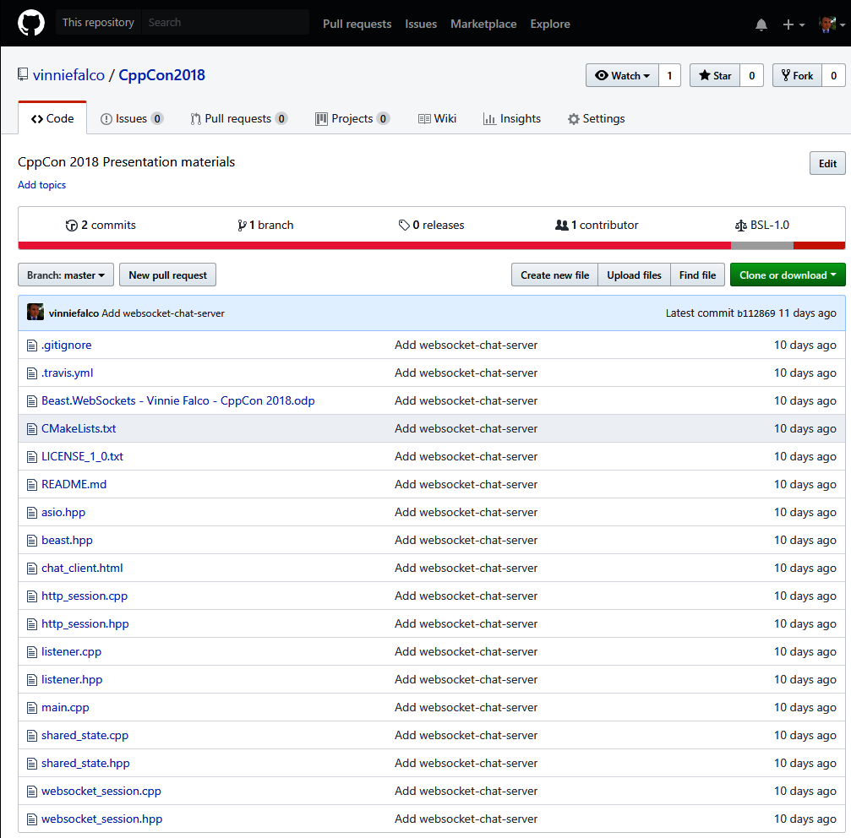
Repository
https://github.com/vinniefalco/CppCon2018

Slide 7
SPOILER ALERT!

Slide 8


Slide 9

Contents
Web Protocols
Interactive Web
WebSockets
Networking TS
Chat Server
Chat Client
Education

Slide 10

Web Protocols

Slide 11








HTTP
“Hypertext Transfer Protocol”
Client
Server
DNS
192.168.17.42
TCP/IP

Slide 12
HTTP
Half-Duplex
Client
Server
HTTP Request
HTTP Response

Slide 13
WebSockets

Slide 14
WebSockets
Message oriented
Routable
Symmetric, full-duplex

Slide 15
WebSocket
GET /chat.cgi HTTP/1.1
Host: www.example.org
Upgrade: websocket
Connection: upgrade
Sec-WebSocket-Key: 2pGeTR08MA==
Sec-WebSocket-Version: 13
User-Agent: Beast
WebSocket Upgrade HTTP request

Slide 16
WebSocket
GET /chat.cgi HTTP/1.1
Host: www.example.org
Upgrade: websocket
Connection: upgrade
Sec-WebSocket-Key: 2pGeTR08MA==
Sec-WebSocket-Version: 13
User-Agent: Beast
TARGET VERSION

Slide 17
WebSocket
HTTP/1.1 101 Switching Protocols
Upgrade: websocket
Connection: upgrade
Sec-WebSocket-Accept: shZRK+xOo=
Server: Beast
WebSocket Upgrade HTTP response

Slide 18
Networking
WinSock (Windows)
epoll (Linux)
kqueue (BSD, OSX)
Operating System

Slide 19
Networking
Networking TS
Net.TS-flavored Boost.Asio
Net.TS-flavored Standalone Asio
Networking TS
Operating System

Slide 20
Networking
Beast HTTP
Beast HTTP
Networking TS
Operating System

Slide 21
Networking
Beast WebSockets
Beast WebSockets
Beast HTTP
Networking TS
Operating System

Slide 22
Networking
Application uses HTTP, WebSockets, Net TS
Application
Beast WebSockets
Beast HTTP
Networking TS
Operating System

Slide 23
Asio
Asynchronous Model
/// Initiate a read
async_read(sock, buffers, handler);

Slide 24
Asio
Socket: Not thread-safe

Slide 25

Boost.Beast HTTP
boost::beast::http::message container
https://youtu.be/WsUnnYEKPnI

Slide 26
Networking.TS

Slide 27
Networking TS
Library | Header file location and namespace
Networking TS | <experimental/io_context> std::experimental::net::io_context
Boost.Asio | <boost/asio/io_context.hpp> boost::asio::io_context
Asio | <asio/io_context.hpp> asio::io_context

Slide 28

Networking TS
// Required for ALL I/O activities
io_context ioc;
// Declare a TCP/IP socket
ip::tcp::socket sock(ioc);
// Write some data
auto bytes_transferred = sock.write_some(b);

Slide 29
Networking TS
template<class ConstBufferSequence>
size_t
socket::write_some(
ConstBufferSequence const& b);
template<class MutableBufferSequence>
size_t
socket::read_some(
MutableBufferSequence const& b);

Slide 30
Buffers
class mutable_buffer
{
...
public:
mutable_buffer();
mutable_buffer(
void*, size_t);
size_t size();
void const* data();
};
class const_buffer
{
...
public:
const_buffer();
const_buffer(
void const*, size_t);
const_buffer(
mutable_buffer);
size_t size();
void const* data();
};

Slide 31
ConstBufferSequence
A ConstBufferSequence is a non-owning range of read-only memory regions.
In this table:
- X is a type meeting the requirements of ConstBufferSequence
- a is a value of type X
Expression | Type | Description
X::value_type | T | T is convertible to const_buffer.
X::const_iterator | U | U is a bidirectional iterator whose reference type is convertible to const_buffer.
X(a) | X | X is CopyConstructible. The copy will reference the same memory regions as the original sequence.
a.begin(); a.end(); | const_iterator or convertible to const_iterator
const_buffer mutable_buffer |  | Also a ConstBufferSequence.

Slide 32
MutableBufferSequence
A MutableBufferSequence is a non-owning range of mutable memory regions.
In this table:
- X is a type meeting the requirements of MutableBufferSequence
- a is a value of type X
Expression | Type | Description
X::value_type | T | T is convertible to mutable_buffer.
X::const_iterator | U | U is a bidirectional iterator whose reference type is convertible to mutable_buffer.
X(a) | X | X is CopyConstructible. The copy will reference the same memory regions as the original sequence.
a.begin(); a.end(); | const_iterator or convertible to const_iterator
mutable_buffer |  | Also a MutableBufferSequence.

Slide 33
Buffers
string s = “Hello, world!”;
sock.write_some(
const_buffer(s.data(), s.size()));
// Better
sock.write_some(buffer(s));

Slide 34
Buffers
template<typename PodType, size_t N>
mutable_buffer buffer(array<PodType, N>& data);
template<typename PodType, size_t N>
const_buffer buffer(array<PodType, N> const& data);
template<typename PodType, typename Allocator>
mutable_buffer buffer(vector<PodType, Allocator>& data);
template<typename PodType, typename Allocator>
const_buffer buffer(vector<PodType, Allocator> const& data);
template<typename Elem, typename Traits, typename Allocator>
mutable_buffer buffer(basic_string<Elem, Traits, Allocator>& data);
template<typename Elem, typename Traits, typename Allocator>
const_buffer buffer(basic_string<Elem, Traits, Allocator> const& data);
// ...26 more overloads

Slide 35
Buffers
// Read data into a buffer until
// it contains a specified string
auto matching_bytes = read_until(sock, b, “\r\n\r\n”);

Slide 36
Buffers
// Read data into a buffer until
// it contains a specified string
auto matching_bytes = read_until(sock, b, “\r\n\r\n”);
template<class SyncReadStream, class DynamicBuffer>
size_t
read_until(
SyncReadStream& s,
DynamicBuffer&& buffers,
string_view match);

Slide 37
Threading Models
Model | Features | Notes
single threaded, single io_context | Fastest Limited capacity Implicit strand | Easiest to write
multi-threaded, single io_context | Highest capacity Explicit strand | Capacity for overhead
multi-threaded, io_context per thread | Fastest Highest capacity Implicit strand Needs balancing | Most complex

Slide 38
Chat Server

Slide 39
Chat Server
// Boost/Asio
namespace net = boost::asio;
using tcp = net::ip::tcp;
using error_code = boost::system::error_code;
// Beast
namespace beast = boost::beast;
namespace http = boost::beast::http;
namespace websocket = boost::beast::websocket;

Slide 40
Chat Server
// Creates and runs the server
int main(int argc, char* argv[]);
// Holds the server data
class shared_state;
// Accepts incoming connections
class listener;
// Handles HTTP requests on a connection
class http_session;
// Maintains an active WebSocket session
class websocket_session;

Slide 41
Chat Server
class shared_state
{
std::string doc_root_;
std::unordered_set<websocket_session*> sessions_;
public:
explicit
shared_state(std::string doc_root);
std::string const&
doc_root() const noexcept { return doc_root_; }
void join (websocket_session& session);
void leave (websocket_session& session);
void send (std::string message);
};

Slide 42
Chat Server
void shared_state::join(websocket_session& session)
{
sessions_.insert(&session);
}
void shared_state::leave(websocket_session& session)
{
sessions_.erase(&session);
}
void shared_state::send(std::string message)
{
auto const ss = std::make_shared<
std::string const>(std::move(message));
for(auto session : sessions_)
session->send(ss);
}

Slide 43
Chat Server
int main(int argc, char* argv[])
{
// Usage:
// websocket-chat-server <address> <port> <doc_root>
auto address =
net::ip::make_address(argv[1]);
auto port =
static_cast<unsigned short>(std::atoi(argv[2]));
auto doc_root = argv[3];
...

Slide 44
Chat Server
int main(int argc, char* argv[])
...
// The io_context is required for all I/O
asio::io_context ioc;
// Create and launch a listening port
std::make_shared<listener>(
ioc,
tcp::endpoint{address, port},
std::make_shared<shared_state>(doc_root)
)->run();
...

Slide 45
Chat Server
int main(int argc, char* argv[])
...
// Capture SIGINT and SIGTERM for clean shutdown
asio::signal_set signals(ioc, SIGINT, SIGTERM);
signals.async_wait(
[&ioc](error_code const&, int)
{
// Stop the io_context. This will cause run()
// to return immediately, destroying the
// io_context and any remaining handlers
ioc.stop();
});
ioc.run();
return EXIT_SUCCESS;
}

Slide 46
Chat Server
class listener
: public std::enable_shared_from_this<listener>
{
tcp::acceptor acceptor_;
tcp::socket socket_;
std::shared_ptr<shared_state> state_;
void fail(error_code ec, char const* what);
void on_accept(error_code ec);
public:
listener(
asio::io_context& ioc,
tcp::endpoint endpoint,
std::shared_ptr<shared_state> const& state);
void run();
};

Slide 47
Chat Server
void listener::run()
{
// Start accepting a connection.
acceptor_.async_accept(
socket_,
[self = shared_from_this()](error_code ec)
{
self->on_accept(ec);
});
}

Slide 48
Chat Server
void listener::on_accept(error_code ec)
{
if(ec)
fail(ec, "accept");
else
// Launch a new session for this connection
std::make_shared<http_session>(
std::move(socket_), state_)->run();
// Accept another connection
acceptor_.async_accept(
socket_,
[self = shared_from_this()](error_code ec)
{
self->on_accept(ec);
});
}

Slide 49
Chat Server
void listener::fail(
error_code ec, char const* what)
{
// Don't report on canceled operations
if(ec == asio::error::operation_aborted)
return;
std::cerr <<
what << ": " <<
ec.message() << "\n";
}

Slide 50
Chat Server
class http_session
: public std::enable_shared_from_this<http_session>
{
tcp::socket socket_;
beast::flat_buffer buffer_;
std::shared_ptr<shared_state> state_;
http::request<http::string_body> req_;
void fail(error_code ec, char const* what);
void on_read(error_code ec, std::size_t);
void on_write(error_code ec, std::size_t, bool close);
public:
http_session(tcp::socket socket,
std::shared_ptr<shared_state> const& state);
void run();
};

Slide 51
Chat Server
http_session::http_session(
tcp::socket socket,
std::shared_ptr<shared_state> const& state)
: socket_(std::move(socket))
, state_(state)
{
}
void http_session::run()
{
// Read a request
http::async_read(socket_, buffer_, req_,
[self = shared_from_this()]
(error_code ec, std::size_t bytes)
{
self->on_read(ec, bytes);
});
}

Slide 52
Chat Server
void http_session::on_read(error_code ec, std::size_t)
{
// This means they closed the connection
if(ec == http::error::end_of_stream)
{
socket_.shutdown(tcp::socket::shutdown_send, ec);
return;
}
if(ec)
return fail(ec, "read");
// Handle WebSocket Upgrade
if(websocket::is_upgrade(req_))
{
// Create a WebSocket session by transferring the socket
std::make_shared<websocket_session>(
std::move(socket_), state_)->run(std::move(req_));
return;
}
...

Slide 53
Chat Server
void http_session::on_read(error_code ec, std::size_t)
...
handle_request(state_->doc_root(), std::move(req_),
[this](auto&& response)
{
using response_type = typename
std::decay<decltype(response)>::type;
auto sp = std::make_shared<response_type>(
std::move(response));
http::async_write(this->socket_, *sp,
[self = shared_from_this(), sp](
error_code ec, std::size_t bytes)
{
self->on_write(ec, bytes, sp->need_eof());
});
});
}

Slide 54
Chat Server
void http_session::on_write(
error_code ec, std::size_t, bool close)
{
if(ec)
return fail(ec, "write");
if(close)
{
// This means we should close the connection,
socket_.shutdown(tcp::socket::shutdown_send, ec);
return;
}
// Clear contents of the request message,
// otherwise the read behavior is undefined.
req_ = {};
// Read another request
http::async_read(socket_, buffer_, req_,
[self = shared_from_this()]
(error_code ec, std::size_t bytes)
{
self->on_read(ec, bytes);
});
}

Slide 55
Chat Server
class websocket_session
: public std::enable_shared_from_this<websocket_session>
{
beast::flat_buffer buffer_;
websocket::stream<tcp::socket> ws_;
std::shared_ptr<shared_state> state_;
std::vector<std::shared_ptr<std::string const>> queue_;
void fail(error_code ec, char const* what);
void on_accept(error_code ec);
void on_read(error_code ec, std::size_t);
void on_write(error_code ec, std::size_t);
public:
~websocket_session();
websocket_session(tcp::socket socket,
std::shared_ptr<shared_state> const& state);
template<class Body, class Allocator>
void run(http::request<Body, http::basic_fields<Allocator>> req);
void send(std::shared_ptr<std::string const> const& ss);
};

Slide 56
Chat Server
template<class Body, class Allocator>
void websocket_session::
run(
http::request<Body, http::basic_fields<Allocator>> req)
{
// Accept the websocket handshake
ws_.async_accept(
req,
[self = shared_from_this](error_code ec)
{
self->on_accept(ec);
});
}

Slide 57
Chat Server
void websocket_session::
on_accept(error_code ec)
{
if(ec)
return fail(ec, "accept");
// Add this session to the list
state_->join(*this);
// Read a message
ws_.async_read(
buffer_,
[sp = shared_from_this()](
error_code ec, std::size_t bytes)
{
sp->on_read(ec, bytes);
});
}

Slide 58
Chat Server
void websocket_session::
on_read(error_code ec, std::size_t)
{
if(ec)
return fail(ec, "read");
// Send to all connections
state_->send(
beast::buffers_to_string(buffer_.data()));
// Clear the buffer
buffer_.consume(buffer_.size());
ws_.async_read(buffer_, [sp = shared_from_this()](
error_code ec, std::size_t bytes)
{
sp->on_read(ec, bytes);
});
}

Slide 59
Chat Server
void websocket_session::
send(std::shared_ptr<std::string const> const& ss)
{
// Always add to queue
queue_.push_back(ss);
// Are we already writing?
if(queue_.size() > 1)
return;
ws_.async_write(
net::buffer(*queue_.front()),
[sp = shared_from_this()](
error_code ec, std::size_t bytes)
{
sp->on_write(ec, bytes);
});
}

Slide 60
Chat Server
void websocket_session::
on_write(error_code ec, std::size_t)
{
if(ec)
return fail(ec, "write");
queue_.erase(queue_.begin());
if(! queue_.empty())
ws_.async_write(
net::buffer(*queue_.front()),
[sp = shared_from_this()](
error_code ec, std::size_t bytes)
{
sp->on_write(ec, bytes);
});
}

Slide 61
Chat Server
void
websocket_session::
fail(error_code ec, char const* what)
{
// Don't report these
if(ec == net::error::operation_aborted ||
ec == websocket::error::closed)
return;
std::cerr << what << ": " <<
ec.message() << "\n";
}

Slide 62
Chat Server
websocket_session::
~websocket_session()
{
state_->leave(*this);
}

Slide 63
Web Server
See if the socket was closed
Check for WebSocket Upgrade request
Calculate HTTP response
Send HTTP response
Read the next request...
...or close the connection.

Slide 64
Chat Client

Slide 65
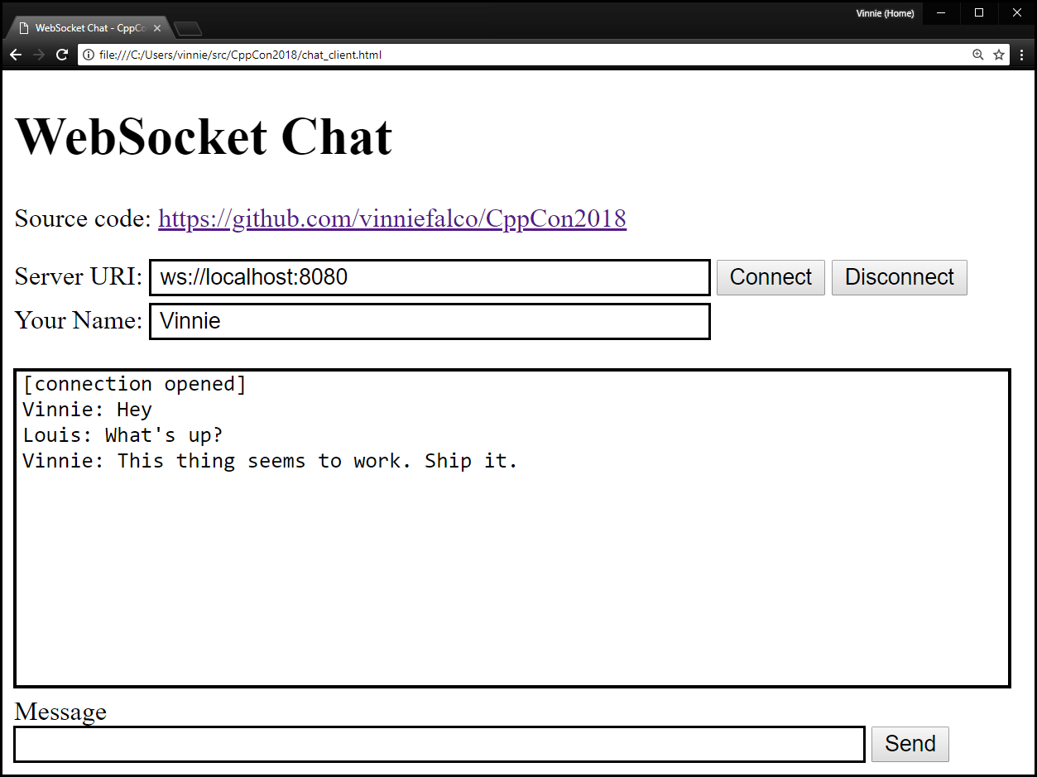
Chat Client

Slide 66
Chat Client
<html>
<head>
<title>WebSocket Chat – CppCon2018</title>
</head>
<body>
<h1>WebSocket Chat</h1>
<!-- UI and app -->
</body>
</html>

Slide 67
Chat Client
Server URI:
<input
id="uri"
size="47"
class="draw-border"
style="margin-bottom: 5px;"
value="ws://localhost:8080">

Slide 68

Chat Client
<button
id="connect"
class="echo-button">
Connect
</button>
<button
id="disconnect"
class="echo-button">
Disconnect
</button>

Slide 69
Chat Client
Your Name:
<input
id="userName"
class="draw-border"
size=47>

Slide 70
Chat Client
<pre
id="messages"
style=”border: solid 1px #cccccc;">
</pre>

Slide 71

Chat Client
Message<br>
<input
id="sendMessage"
class="draw-border">
<button
id="send"
class="echo-button">Send</button>

Slide 72


Slide 73

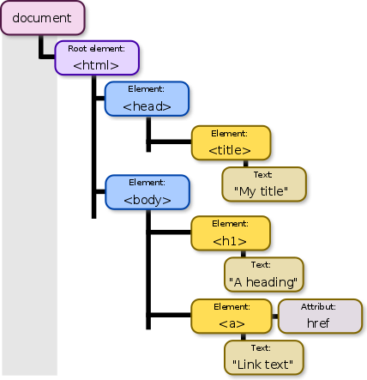
DOM
Document Object Model
DOM
Document Object Model

Slide 74
Chat Client
<script>
var ws = null;
connect.onclick = function() {
ws = new WebSocket(uri.value);
...
};
</script>
id="uri" id="connect"

Slide 75
Chat Client
connect.onclick = function() {
...
ws.onopen = function(ev) {
messages.innerText +=
"[connection opened]\n";
};
ws.onclose = function(ev) {
messages.innerText +=
"[connection closed]\n";
};

Slide 76
Chat Client
connect.onclick = function() {
...
ws.onmessage = function(ev) {
messages.innerText += ev.data + "\n";
};
ws.onerror = function(ev) {
messages.innerText += "[error]\n";
console.log(ev);
};

Slide 77
Chat Client
<script>
var ws = null;
connect.onclick = function() {
ws = new WebSocket(uri.value);
...
};
</script>
id="sendMessage" id="send"

Slide 78
Education

Slide 79
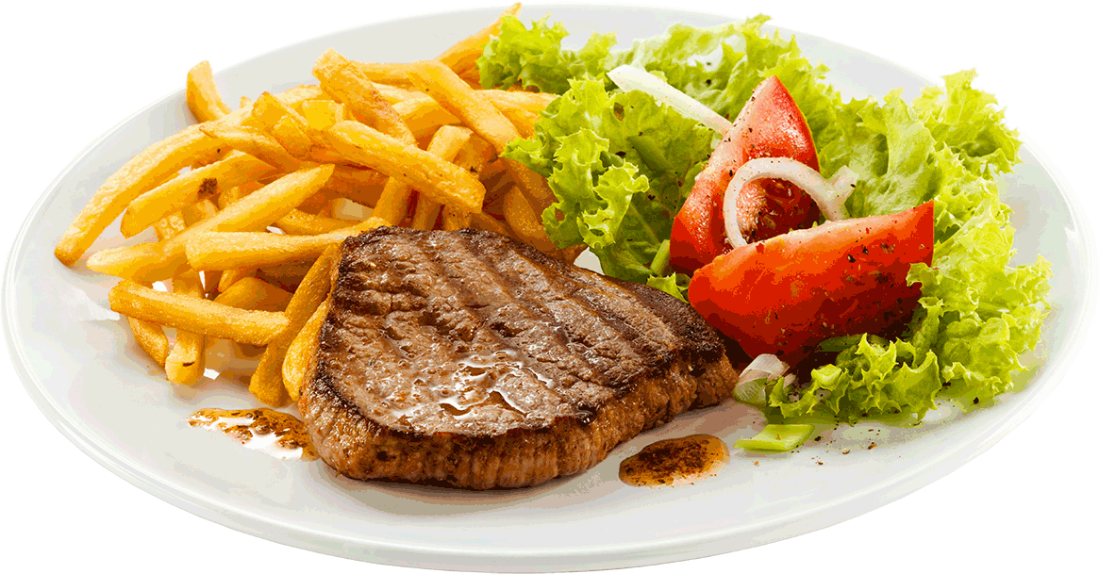
Summary
// Code and slides from the talk
https://github.com/vinniefalco/CppCon2018
// Boost.Beast library
https://github.com/boostorg/beast
// List of Boost libraries, including Boost.Asio
https://www.boost.org/doc/libs/
Speaker’s Dinner

